Slide 1
Data Distribution
By: Derrick Murphy
Dr. Jones
CSC 4388

Slide 2
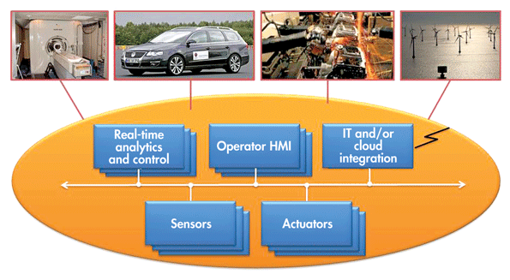
What is Data Distribution Service?
Data Distribution Service is a protocol for the Internet of Things which enables network interoperability for associated machines, enterprise systems, and mobile devices.
The data distribution service standard contains an easy to use, well defined Application Programming Interface(API).
APIs allows the developer to write portable codes that will work with any compliant Data Distribution Services implementation.

Slide 3
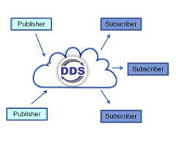
How does Data Distribution Service work?
Data Distribution Systems are in charge of transferring information
Information is transferred from publishers (producers and senders of messages) to subscribers (consumers and receivers of messages).
Operating on unlike platforms or operating systems subscribers and publishers using DDS can and still communicate with one another.
Exchanges can happen between tens of thousands of devices at the simultaneously
Each one of which can be publishers, subscribers, or both simultaneously.

Slide 4
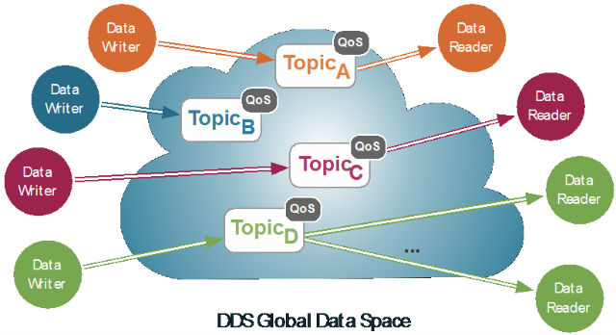
Data Analytics of Data Distributions
DDS automatically recognizes how to send and receive messages with other DDS users.
Data Distribution Service middleware uses logical QoS policies.
Data differ in priority, reliability, timing, and other non-functional properties.
QoS policies cover many characteristics, including urgency, importance, reliability, persistence, and liveliness.

Slide 5
Summary
Data Distribution Service is a type of Communications Middleware.
Data Distribution Service technology increases software development, increases safety, and aids implementation and maintenance issues in dynamic systems.
Data Distribution Service interoperability allows clients to enhance one DDS implementation with another appropriate to their requirements.
extend already implemented systems with new applications.

Slide 6
Reference
Anon. What Can DDS do for Android? Retrieved January 27, 2017 from http://www.omg.org/hot-topics/documents/dds/Android_and_DDS1.pdf
Anon. What is DDS? Retrieved January 27, 2017 from http://portals.omg.org/dds/what-is-dds-3/
Anon. How Does DDS Work? Retrieved January 29, 2017 from http://portals.omg.org/dds/how-dds-works/

